Slide 1
WOMEN SAFETY APP
BY
SIVANE SENTHIL E0121027
SWATHY SURESH E0121046

Slide 2
CONTENTS
INTRODUCTION
AIM
ROLE OF THE APP
CODE
DEMO VIDEO

Slide 3
INTRODUCTION
THE WOMEN SAFETY IS THE PRIME CONCERN IN TODAY’S WORLD CONSIDERING THE JUMP IN THE NUMBER OF INCIDENTS AND CRIME RATES AGAINST WOMEN, ESPECIALLY IN THE METRO CITIES WHERE WOMEN HAVE TO STAY OUT FOR LONG.
AS WOMEN NEED TO TRAVEL LATE NIGHT SOMETIMES, IT IS IMPORTANT TO STAY ALERT AND SAFE. ALTHOUGH THE GOVERNMENT IS TAKING NECESSARY MEASURES FOR THEIR SAFETY, STILL, THERE ARE FREE SAFETY APPS FOR WOMEN THAT CAN HELP THEM TO STAY SAFE.
MOST OF THE FEMALES NOWADAYS CARRY THEIR SMARTPHONE WITH THEMSELVES, SO IT IS NECESSARY TO HAVE AT LEAST ONE THE BELOW-MENTIONED PERSONAL SAFETY APPS INSTALLED. SUCH A SAFETY APP FOR GIRLS CAN CERTAINLY HELP IN SOME WAY OR THE OTHER.

Slide 4
AIM
THE BASIC AIM OF THE SYSTEM IS TO DEVELOP A LOW COST SOLUTION FOR GPS BASED WOMEN TRACKING SYSTEM WHICH CAN BE APPLIED TO VARIOUS DOMAINS OF THE INDUSTRIAL AND PERSONAL USE JUST BY USING THE VERY COMMON MEAN I.E. MOBILE WITH ANDROID ENABLED.
THE MAIN OBJECTIVE OF THE SYSTEM IS TO TRACK THE PERSON WHICH HAS AN ANDROID ENABLED MOBILE BY EXTRACTING THE LONGITUDE AND LATITUDE OF THAT TARGET PERSON.
THE PRIMARY OBJECTIVE OF OUR SYSTEM IS TO TRACK THE PERSON AND PLOT OF THE LOCATION ON REAL TIME SYSTEM LIKE GOOGLE MAP.

Slide 5
ROLE OF THE APP
THE PROPOSED APP IS BASED ON ADVANCED SENSORS. EACH TIME A USER MAKES A PHONE CALL, AN EMERGENCY SIGNAL WILL BE GENERATED AUTOMATICALLY AND THEN AN INFORMATION ALERT WILL BE SENT TO THE CONTACTS THAT HAVE BEEN ADDED TO THE EMERGENCY CALL.
IT CONSISTS OF A GPS DEVICE AND THE UNIT WILL PROVIDE STATUS INFORMATION SUCH AS LATITUDE, THE LONGITUDE OF THE USER.

Slide 6
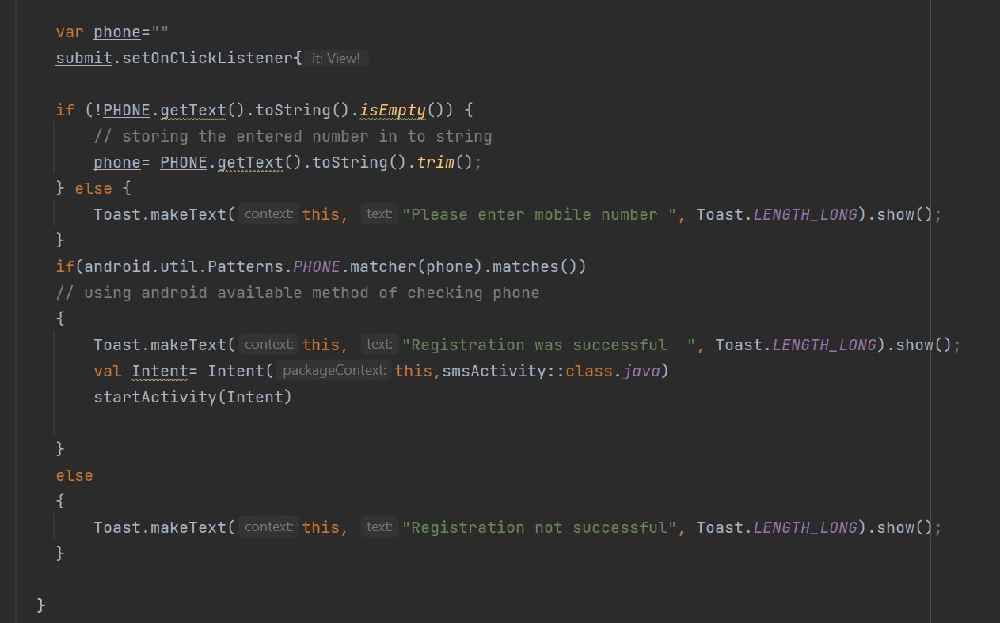
CODE (registration)

Slide 7
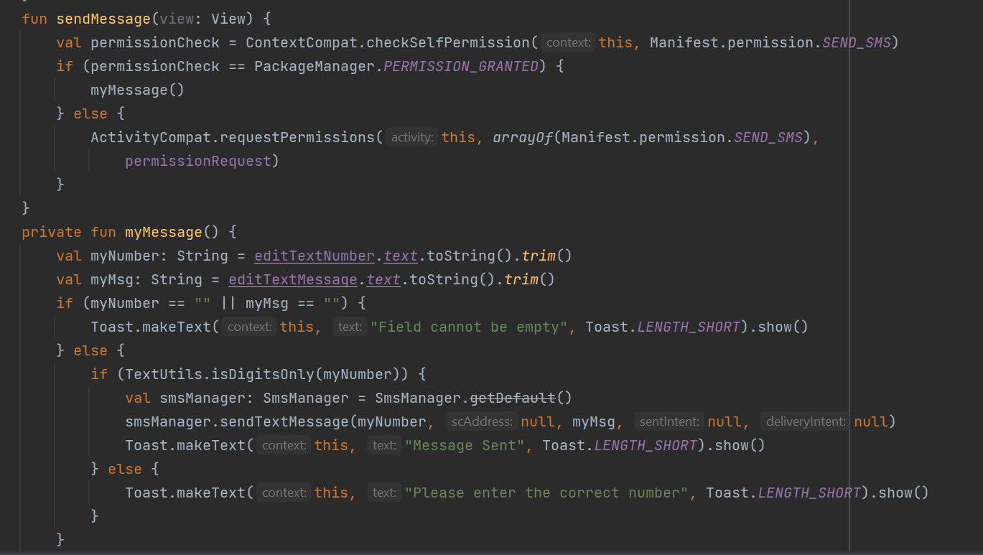
CODE(message)

Slide 8
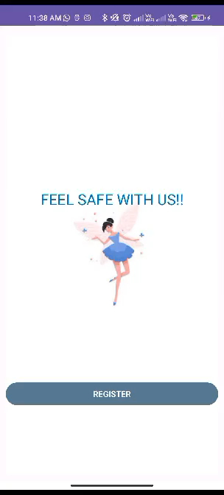
DEMO VIDEO

Slide 9
FUTURE SCOPE
Send GEOGRAPHICAL LOCATION instead of message
Message button activates when phone is SHAKED

Slide 10
THANK YOU

